Slide 1
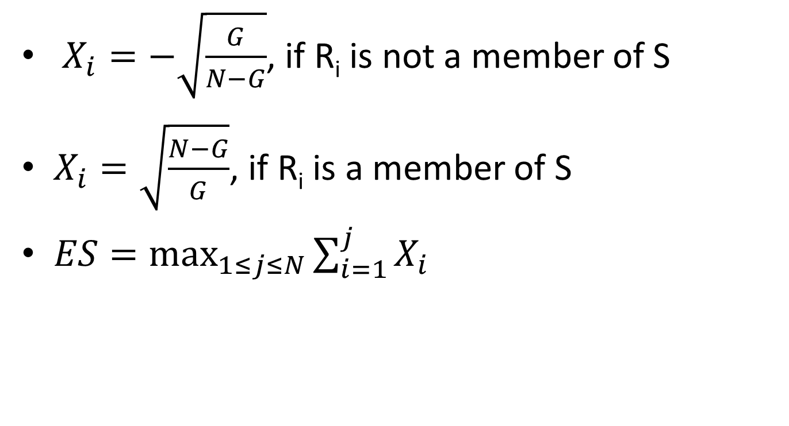
Formula in Mootha’s paper
$X_{i}=−\sqrt{\frac{G}{N−G}}$, if R_{i} is not a member of S
$X_{i}=\sqrt{\frac{N−G}{G}}$, if R_{i} is a member of S
$ES=\max_{1≤j≤N}{\sum_{i=1}^{j}{X_{i}}}$

Slide 2
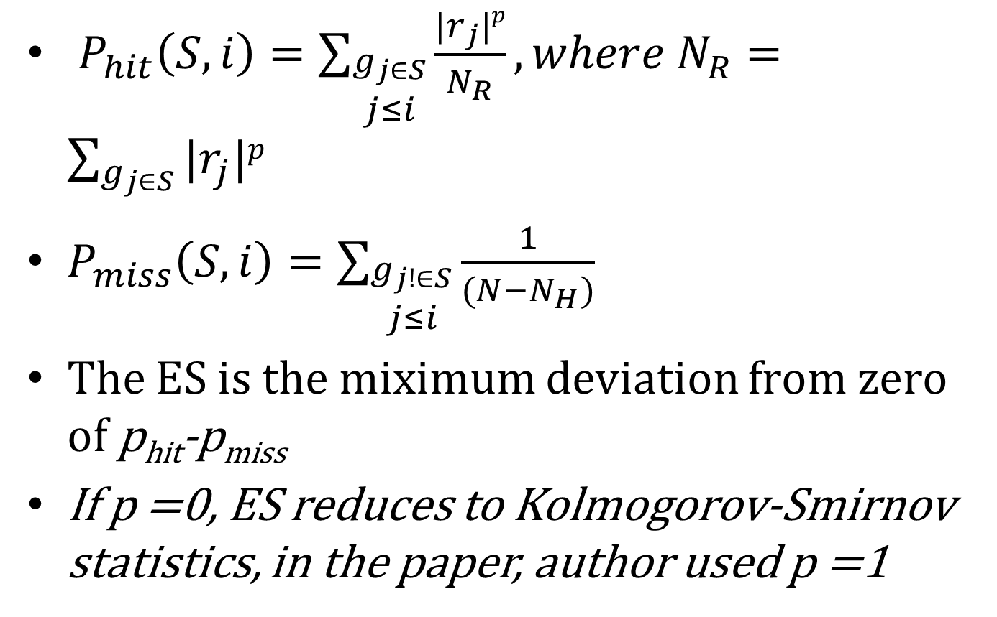
Formula in subramanian’s pnas
$P_{hit}\left(S,i\right)=\sum_{\begin{aligned}g_{j∈S} \\ j≤i\end{aligned}}{\frac{|r_{j}|p}{N_{R}}},where N_{R}=\sum_{g_{j∈S}}{|r_{j}|p}$
$P_{miss}\left(S,i\right)=\sum_{\begin{aligned}g_{j!∈S} \\ j≤i\end{aligned}}{\frac{1}{(N−N_{H})}}$
The ES is the miximum deviation from zero of p_{hit}-p_{miss}
If p =0, ES reduces to Kolmogorov-Smirnov statistics, in the paper, author used p =1

Slide 3
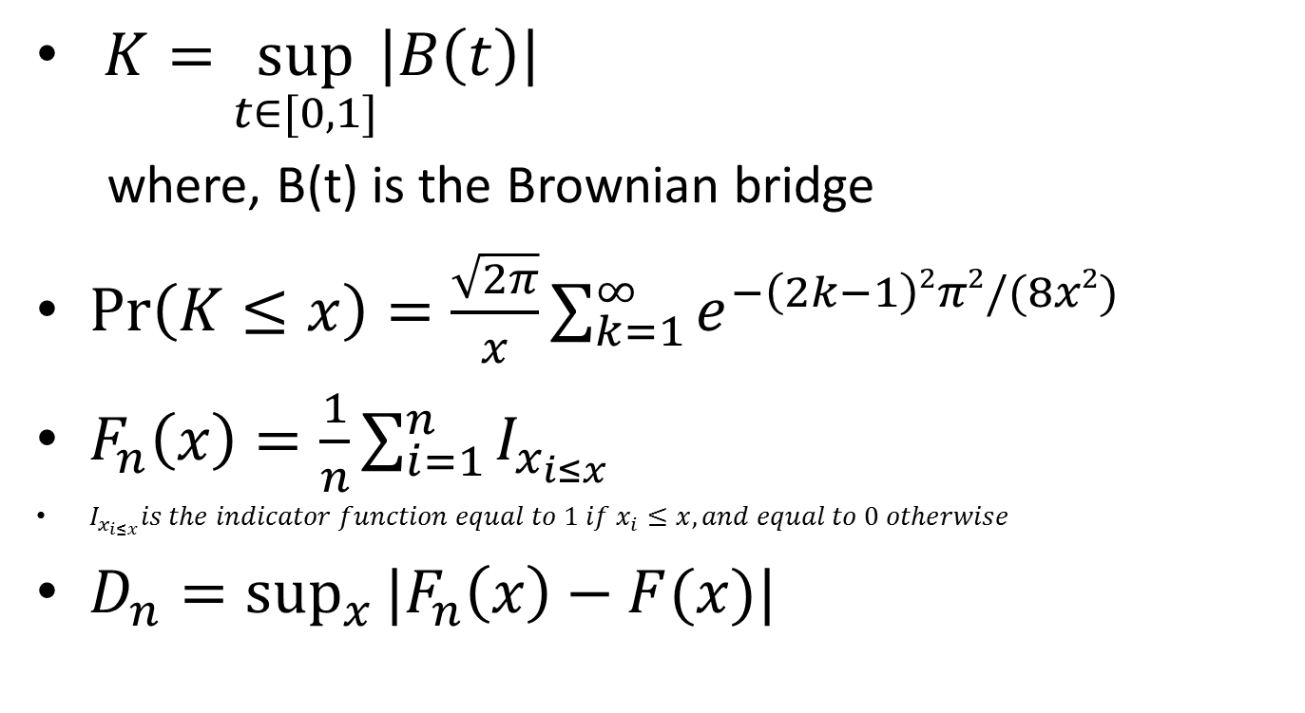
Kolmogorov – Smirnov test
$K=\sup_{t∈[0,1]}\left|B\left(t\right)\right|$
where, B(t) is the Brownian bridge
$\operatorname{Pr}\left(K≤x\right)=\frac{\sqrt{2π}}{x}\sum_{k=1}^{∞}{e^{−\left(2k−1\right)2π2/(8x2)}}$
$F_{n}\left(x\right)=\frac{1}{n}\sum_{i=1}^{n}{I_{x_{i≤x}}}$
$I_{x_{i≤x}}is the indicator function equal to 1 if x_{i}≤x, and equal to 0 otherwise$
$D_{n}=\sup_{x}{|F_{n}\left(x\right)−F(x)|}$

